Slide 1
This is CS50

Slide 2
Announcements 🍂
Masks are required. Please do not put classmates in a position of risk or discomfort by not adhering to protocol. And please do not put staff in a position of having to remind or escalate. Step outside or watch online instead.
No food or drink in Sanders, please!
If you'd like to view the projector screen on your own laptop during class and/or ask Carter questions via chat, visit cs50.ly/sanders, which will open a Zoom webinar. Be sure to mute your audio, as this week's webinar also contains video for those in isolation or quarantine.

Slide 3
This is CS50

Slide 4
#include <stdio.h>
int main(void) {
printf("Thank you, Luke!\n");
}

Slide 5
print("Thank you, Luke!")

Slide 6
This is CS50
Notes:
speller.py

Slide 7
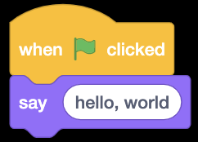

Slide 8
#include <stdio.h>
int main(void) {
printf("hello, world\n");
}

Slide 9
print("hello, world")

Slide 11
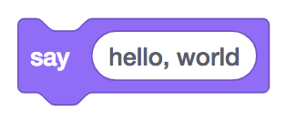
printf("hello, world");

Slide 12
printf("hello, world\n");;

Slide 13
print("hello, world");

Slide 15
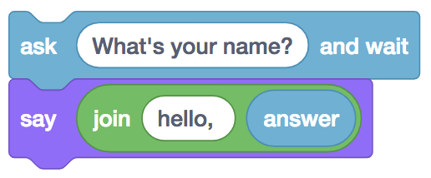
string answer = get_string("What's your name?\n");
printf("hello, %s\n", answer);

Slide 16
string answer = get_string("What's your name? ");
printf("hello, %s\n", answer);

Slide 17
answer = get_string("What's your name? ")
print("hello, " + answer)

Slide 18
answer = get_string("What's your name? ")
print("hello, " + answer)

Slide 19
answer = get_string("What's your name? ")
print("hello, " + answer)

Slide 20
answer = get_string("What's your name? ")
print(f"hello, {answer}")

Slide 22
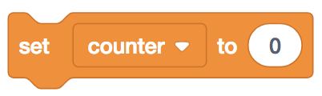
int counter = 0;

Slide 23
int counter = 0;

Slide 24
counter = 0

Slide 25
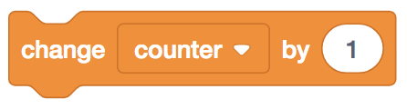
counter = counter + 1;

Slide 26
counter = counter + 1;

Slide 27
counter = counter + 1

Slide 28
counter += 1;

Slide 29
counter += 1

Slide 31
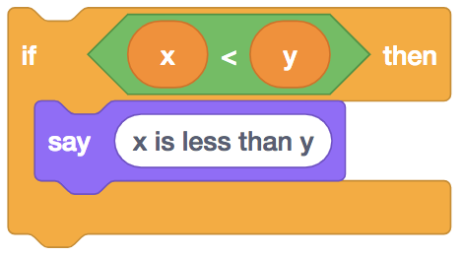
if (x < y) {
printf("x is less than y\n");
}

Slide 32
if (x < y) {
printf("x is less than y\n");
}

Slide 33
if x < y:
print("x is less than y")

Slide 35
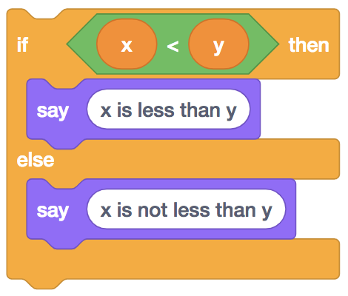
if (x < y) {
printf("x is less than y\n");
}
else
{ printf("x is not less than y\n");
}

Slide 36
if (x < y) {
printf("x is less than y\n");
}
else
{ printf("x is not less than y\n");
}

Slide 37
if x < y:
print("x is less than y")
else: print("x is not less than y")

Slide 39
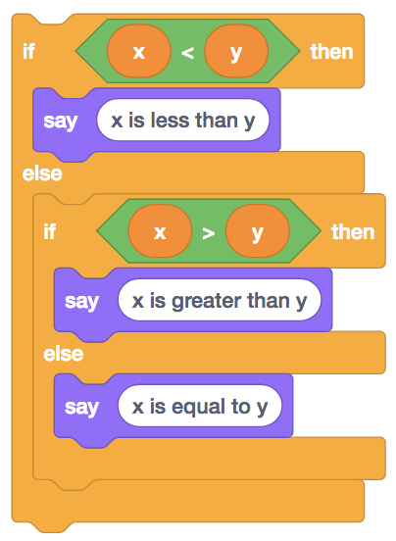
if (x < y) {
printf("x is less than y\n");
}
else if (x > y)
{ printf("x is greater than y\n");
}
else
{ printf("x is equal to y\n");
}

Slide 40
if (x < y) {
printf("x is less than y\n");
}
else if (x > y)
{ printf("x is greater than y\n");
}
else
{ printf("x is equal to y\n");
}

Slide 41
if x < y:
print("x is less than y")
elif x > y: print("x is greater than y")
else: print("x is equal to y")

Slide 43
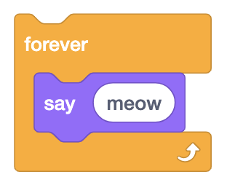
while (true)
{
printf("meow\n");
}

Slide 44
while (true)
{
printf("meow\n");
}

Slide 45
while True:
print("meow")

Slide 47
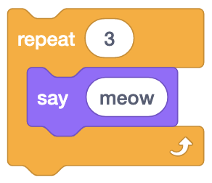
int i = 0;
while (i < 3)
{
printf("meow\n");
i++;
}

Slide 48
int i = 0;
while (i < 3)
{
printf("meow\n");
i++;
}

Slide 49
i = 0
while i < 3:
print("meow")
i += 1

Slide 50
for (int i = 0; i < 3; i++)
{
printf("meow\n");
}

Slide 51
for (int i = 0; i < 3; i++)
{
printf("meow\n");
}

Slide 52
for i in [0, 1, 2]:
print("hello, world")

Slide 53
for i in range(3):
print("hello, world")

Slide 54
bool
char
double
float
int
long
string
...

Slide 55
bool
float
int
str
...

Slide 56
range sequence of numbers
list sequence of mutable values
tuple sequence of immutable values
dict collection of key-value pairs
set collection of unique values
...

Slide 57
range sequence of numbers
list sequence of mutable values
tuple sequence of immutable values
dict collection of key-value pairs
set collection of unique values
...

Slide 58
get_char
get_double
get_float
get_int
get_long
get_string
...

Slide 59
get_float
get_int
get_string

Slide 60
#include <cs50.h>

Slide 61
import cs50

Slide 62
from cs50 import get_float from cs50 import get_int from cs50 import get_string

Slide 63
from cs50 import get_float, get_int, get_string
Notes:
hello1.py

Slide 64
#include <stdio.h>
int main(void) {
printf("hello, world\n");
}

Slide 65
make hello
./hello

Slide 66
clang -o hello hello.c -lcs50
./hello

Slide 67
print("hello, world")

Slide 68
python hello.py
Notes:
hello.py
[no main]

Slide 69
interpreter
source code →

Slide 70
1 Recoge guía telefónica
2 Abre a la mitad de guía telefónica
3 Ve la página
4 Si la persona está en la página
5 Llama a la persona
6 Si no, si la persona está antes de mitad de guía telefónica
7 Abre a la mitad de la mitad izquierda de la guía telefónica
8 Regresa a la línea 3
9 Si no, si la persona está después de mitad de guía telefónica
10 Abre a la mitad de la mitad derecha de la guía telefónica
11 Regresa a la línea 3
12 De lo contrario
13 Abandona

Slide 71
1 Pick up phone book
2 Open to middle of phone book
3 Look at page
4 If person is on page
5 Call person
6 Else if person is earlier in book
7 Open to middle of left half of book
8 Go back to line 3
9 Else if person is later in book
10 Open to middle of right half of book
11 Go back to line 3
12 Else
13 Quit
Notes:
1/hello*
calculator0*

Slide 72
This is CS50
Notes:
1/hello*
1/calculator0

Slide 73
input
Notes:
calculator1.py

Slide 74
OOP

Slide 75
floating-point imprecision
Notes:
1.0 / 10.0

Slide 76
exceptions

Slide 77
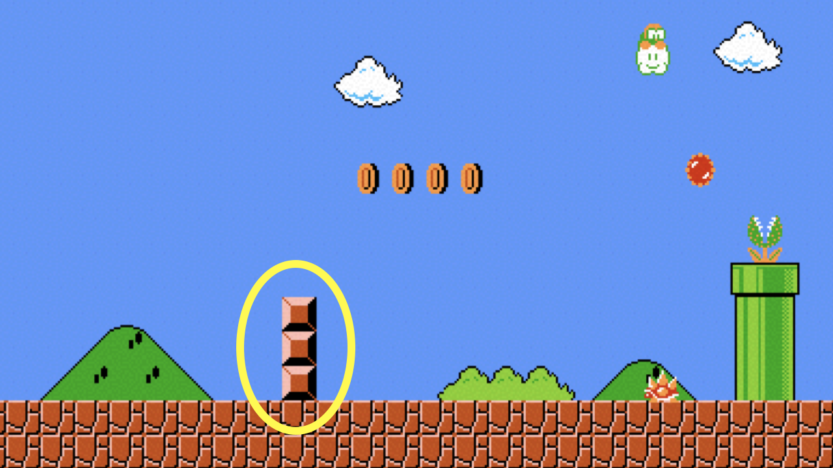

Slide 78
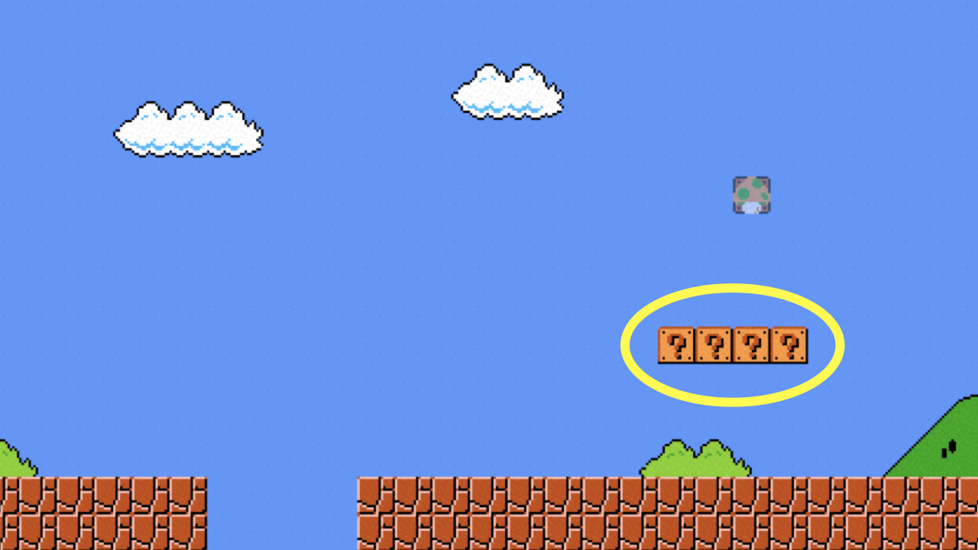

Slide 79
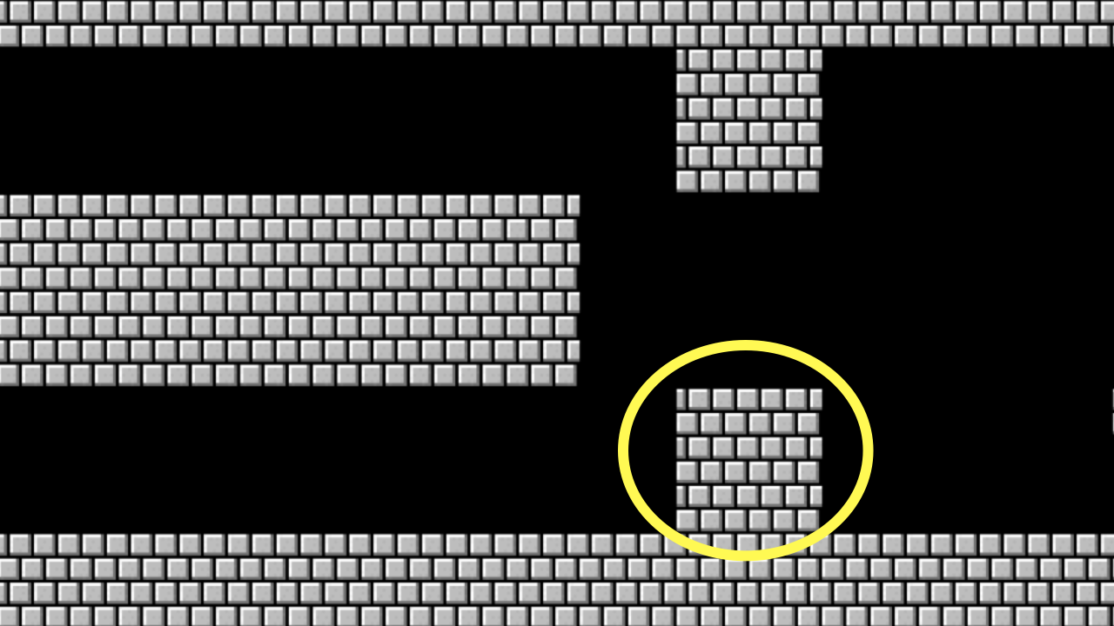

Slide 80
docs.python.org
Notes:
https://docs.python.org/3/library/stdtypes.html?highlight=capitalize#str.capitalize

Slide 81
integer overflow

Slide 82
cs50.ly/hogwarts
Notes:
https://docs.google.com/spreadsheets/d/1IaEk05RrPoHI4hMH3oYugECXOeb8R1IhbrJPxIvmQO0/edit?usp=sharing

Slide 83
regular expressions

Slide 84
. any character
.* 0 or more characters
.+ 1 or more characters
? optional
^ start of input
$ end of input
...
Notes:
agree2.py

Slide 85
This is CS50

